Slide 1


Automated Brain Tumor Detection and Segmentation

Slide 2

CONTENTS
1. Team Members
2. Introduction & Project Goal
3. Dataset Overview
4. The Full Project Pipeline
5. Current Progress - Module 1: Preprocessing
6. Planned Next Steps
7. Team Roles and Responsibilities
8. Thank You

Slide 3






1. Team Members
1
V. Vamsi Krishna (2022BCD0022)
2
K. Surya Poojith (2022BCD0025)
3
K. Sathvik Kiran (2022BCD0028)
4
Mohammed Abdul Rahim Zuhair (2022BCS0109)
5
Kethavath Gayathri (2022BCS0196)
6
J. Rushikesh (2022BCS0151)

Slide 4
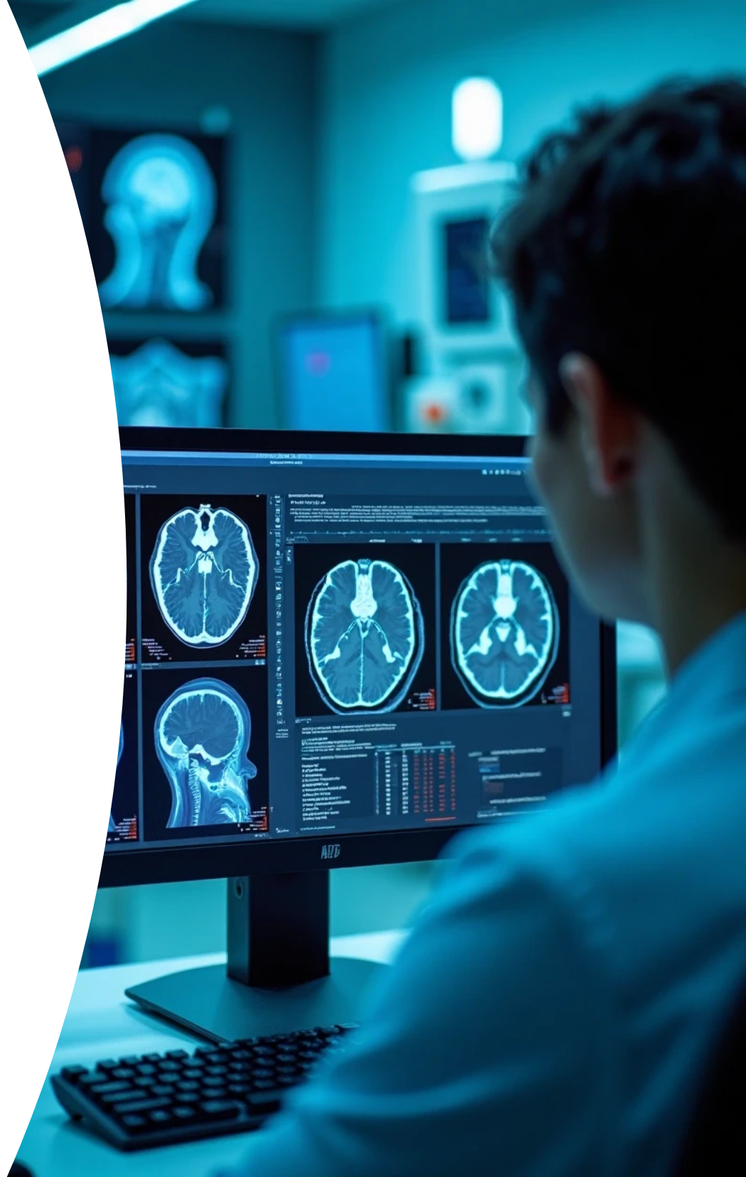
2. Introduction & Project Goal
The Problem
Manually analyzing hundreds of MRI scans for brain tumors is time-consuming and prone to human error. An automated system can provide fast, objective, and repeatable results.
Our Project Goal
To design and implement a complete image processing pipeline to automatically detect and segment three types of brain tumors (meningioma, glioma, and pituitary) from MRI scans.

Slide 5





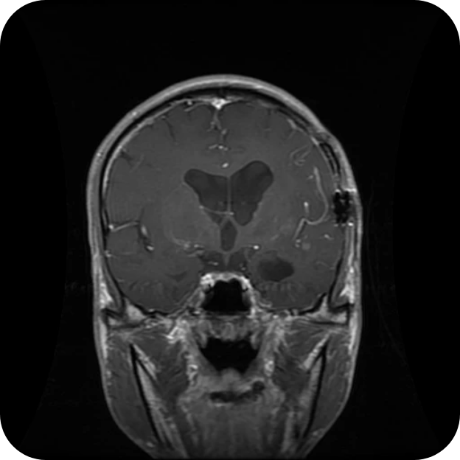
Dataset Overview
1
2
Dataset
Ground Truth
• A public dataset from Figshare containing 3064 T1-weighted contrast-enhanced MRI images.
• Each MRI scan (e.g., 209.png) has a corresponding ground truth mask (209_mask.png).
• Images are sorted into three categories: Meningioma, Glioma, and Pituitary tumor.
• This mask is crucial as it will allow us to quantitatively evaluate our algorithm's accuracy in later stages.

Slide 6

4. The Full Project Pipeline
This project is structured into a 6-module pipeline. For this first review, we have focused on completing Module 1.

Slide 7


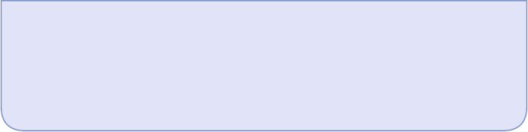
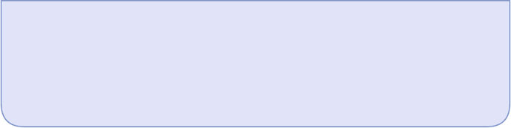
Our Complete Plan
1
2
Image Preprocessing
Skull Stripping
Clean and prepare the image data. (Completed)
Isolate the brain tissue.
3
4
Contrast Enhancement
Tumor Segmentation
Make the tumor more visible.
Isolate the tumor with an algorithm.
5
6
Feature Analysis & Evaluation
Visualization
Quantify the tumor and score our accuracy.
Display the final result.

Slide 8
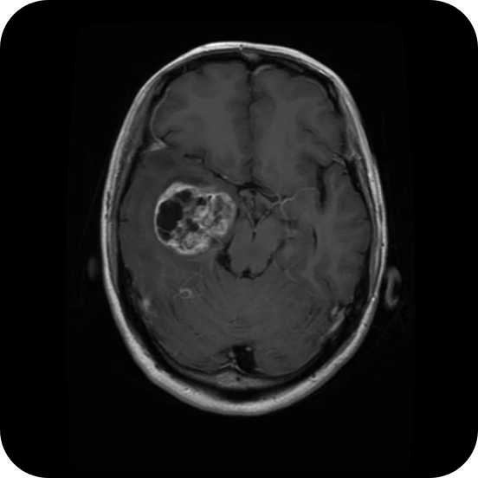

5. Module 1: Preprocessing
We have successfully implemented the foundational preprocessing module.
Data Loading: Images and their corresponding masks are loaded directly from the organized folders.
Noise Reduction: A median filter is applied to each MRI scan.
Purpose
The median filter reduces "salt-and-pepper" noise, which is common in medical images. This step is critical for preventing the detection of false edges in later stages. It preserves sharp boundaries better than averaging filters.

Slide 9


Module 2 : Skull Stripping (Brain Extraction)
1
Task Definition
2
Segmentation Techniques
Remove non-brain tissues from images.
Utilize thresholding and morphological operations.
3
Goal
4
Next Steps
Isolate the brain region efficiently.
Proceed to contrast enhancement in Module 3.

Slide 10
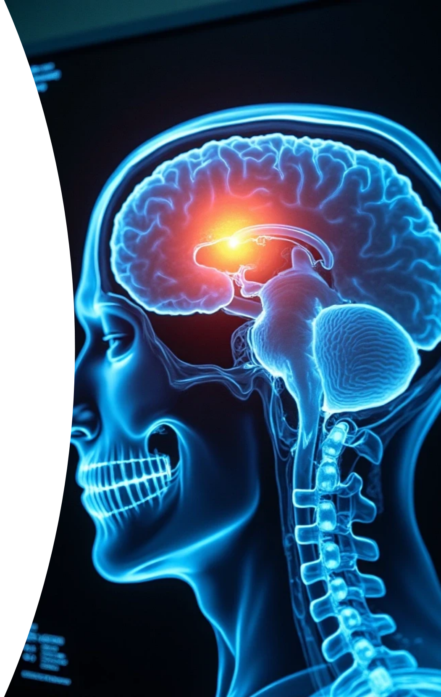




Module 3: Contrast Enhancement
1
CLAHE Technique
2
Tumor Distinction
3
Noise Prevention
Applies contrast enhancement locally instead of globally.
Makes tumors more visible in medical images.
Avoids over-amplification of noise in image tiles.
4
Local vs Global
5
Application in Imaging
6
Next Steps
Proceed to further analysis and interpretation.
Local enhancement improves detail versus standard techniques.
Essential for improving diagnostic capabilities.

Slide 11
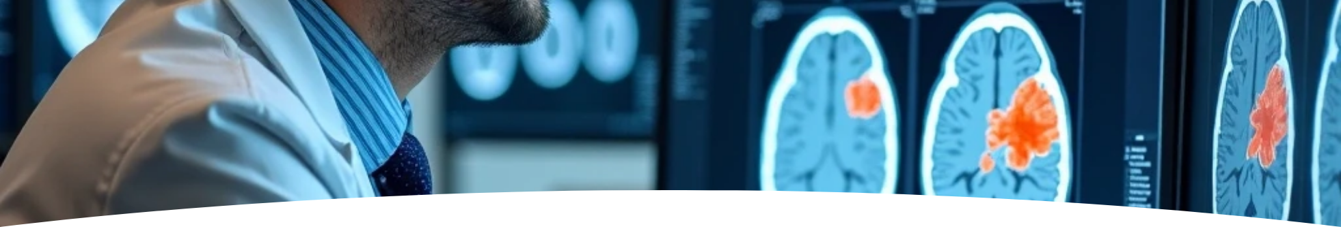



Module 4: Tumor Segmentation
1
Isolate the tumor
2
Otsu's Thresholding
Generate a binary mask to distinguish the tumor.
Primary method for optimal tumor-background separation.
3
Canny Edge Detector
4
Bimodal Histogram
Identifies the tumor's boundaries for segmentation.
Assumes histogram shape post-CLAHE application.
5
Enhancement Connection
6
Next Steps
Links with previous contrast enhancement techniques.
Preparation for core analysis in following modules.

Slide 12
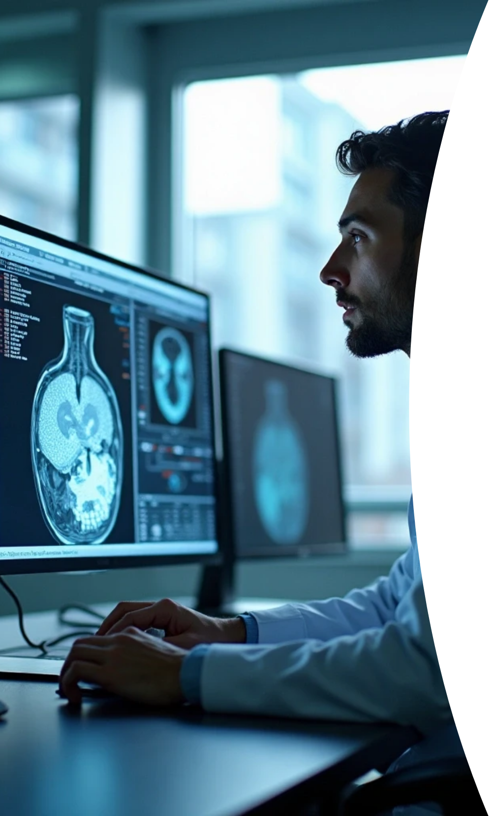




Module 5: Feature Analysis
1
Quantitative Feature Calculation
Measure region properties like area, perimeter, and centroid from the tumor mask.
2
Ground Truth Comparison
Evaluate the accuracy of our generated mask against the actual tumor mask.
3
Accuracy Metrics
Utilize Dice Coefficient / IoU for performance measurement.

Slide 13
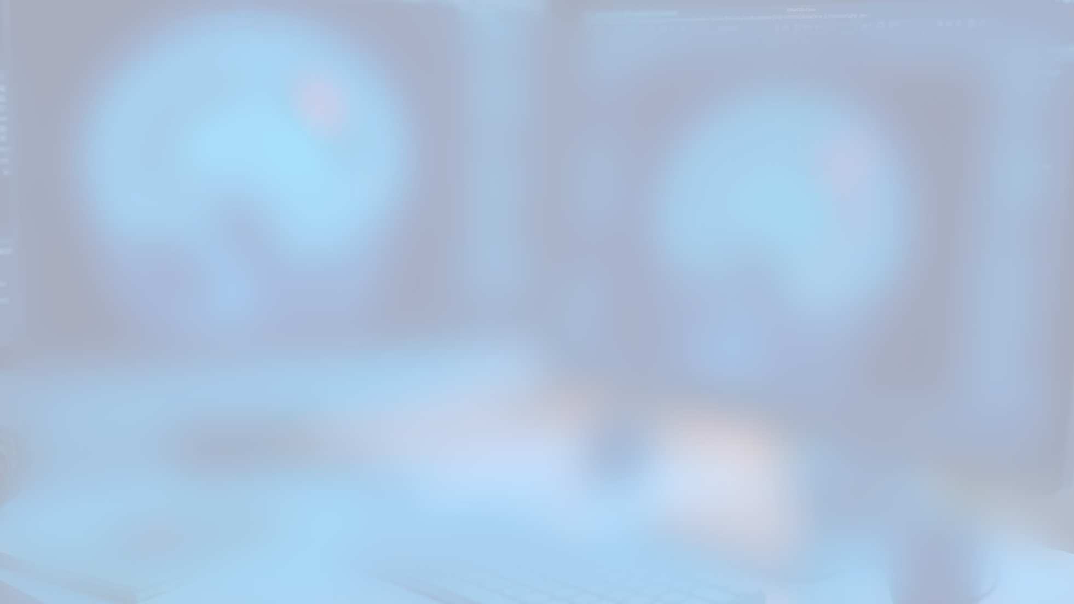
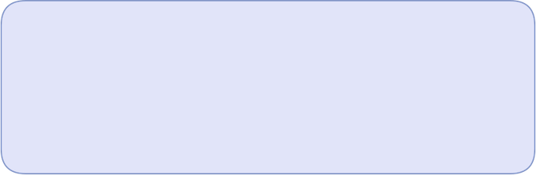
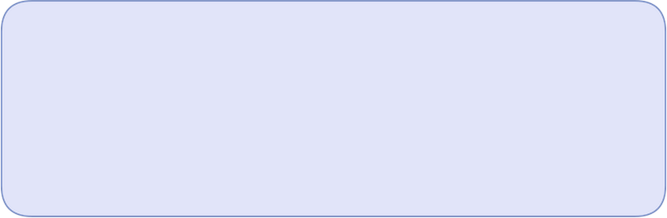

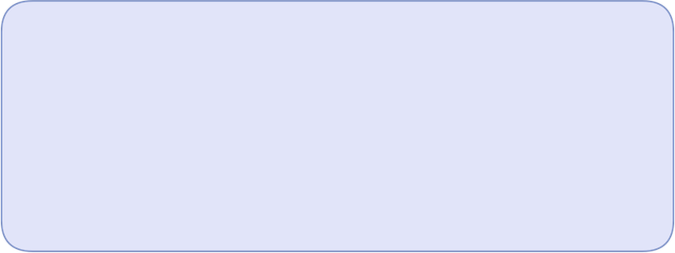
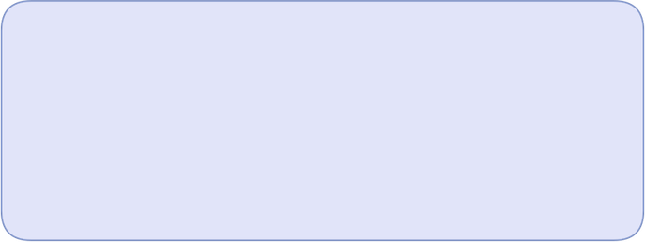

6. Planned Next Steps
Following our successful completion of Phase 1, our next steps will focus on the core analysis:
1
2
Module 2
Module 3
Skull Stripping: We will use thresholding and morphological operations (erosion/dilation) to create a clean mask of the brain.
Contrast Enhancement: We plan to apply CLAHE to locally enhance the contrast between the tumor and healthy tissue.
3
4
Module 4
Modules 5 & 6
Tumor Segmentation: We will use Otsu's thresholding method to automatically segment the tumor, assuming a bimodal histogram after enhancement.
Evaluation and Visualization: Finally, we will calculate the Dice Coefficient for accuracy and overlay the results on the original image.

Slide 14
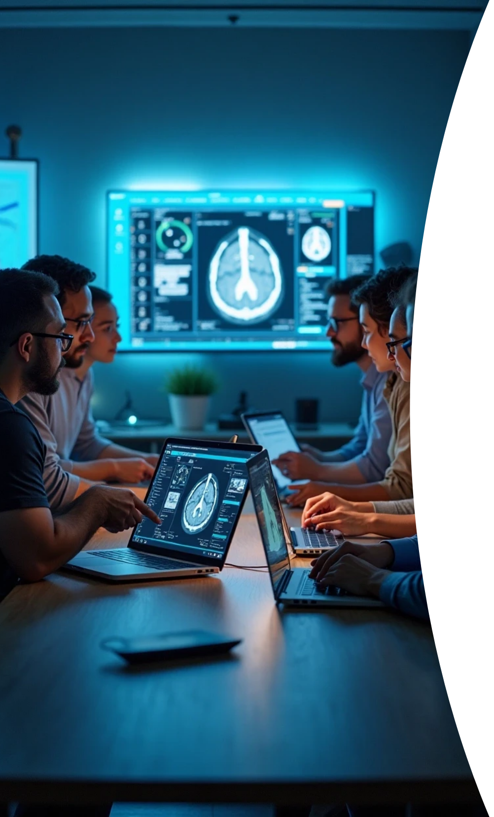
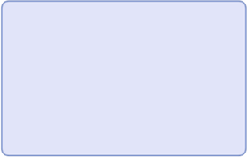
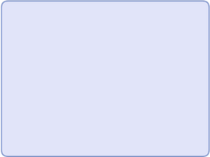
7. Team Roles and Responsibilities
The project workload for all six modules has been clearly distributed:
J.Rushikesh
Sathvik
Abdul Rahim Zuhair
Module 1 - Data Loading & Preprocessing
Module 2 - Skull Stripping
Module 3 - Contrast Enhancement
V.Vamsi Krishna
K.Surya Poojith
Kethavath Gayathri
Module 4 - Tumor Segmentation
Module 5 - Feature Analysis & Evaluation
Module 6 - Visualization & UI Integration

Slide 15

Thank You

